Slide 1

Case Study
AKS University

Slide 2



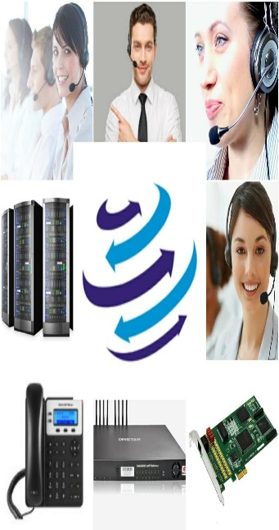



+91-856-00-00-600
www.dialerindia.com
avyuktaindia
CRM Based Dialer - IVR - Cloud Telephony
PRI Card - GSM Gateway - Servers - Headsets
(FXS/FXO/IP Phone// Press 1/ IP PBX)
Auto / Predictive / Hosted – WFH - PC Less – Android - Cloud Dialer
DoT Approved A / A+ Grade VoIP with/out Dialer Combo
Web / Software Development/e-Com / Custom Asterisk Solutions
+1-408-791-3820
+91-856-00-00-600
sales@dialerindia.com

Slide 3
Case Study AKS University
About AKS University
The AKS University (Amicable Knowledge Solution) Satna, Madhya Pradesh was established in 2011.AKS University is a private university which is run by Charitable Trust that was founded with a mission to provide education to everyone. It aims to render social service and is committed to provide quality and affordable education to everyone regardless of caste, creed, religion or culture. AKS University is an initiative of the Rajiv Gandhi Group of Institutions.
Inspired by the ideas and philosophy of chancellor Shri B. P. Soni as dynamic & energetic Chairman and Er. Anant Kumar Soni. The trust works for the welfare and development of mankind and imbibes ethical principles. The aim of this trust is to guide the energy of the youth of our country in the right direction. This aim can only be achieved by educating the youth.

Slide 4
Case Study AKS University
Key Challenges Areas of AKS University
1. AKS Technical counterparts were Looking for a solution which can be integrated with their
existing PBX solution with 300 plus extensions for both incoming and outgoing calls.
2. They were seeking for a solution where they can fetch complete reporting of all calls for all
kind of queries from students such as fee query or admission related or any other query.
3. They were seeking for a solution for incoming calls distribution with in concerned departments
or respective person as per the user inputs
4. They were Looking for a solution for all call’s notification to concerns with automated SMS
notification to caller for their queries/alert like fees deposition, fee structure, amount to be
paid , other receipts as well as if anybody call for some course related details all details will be
delivered by SMS automatically.
5. They were looking for a centralised solution with which they can fetch data and recording for
further follow-ups or auditing purpose, as well as all Call-back schedules for follow-up.

Slide 5
Case Study AKS University
Solutions we implemented at AKS University
We had implemented Avyukta Dialler Suite with both GSM gateway and PRI Line allocation as per their requirements for both inbound and outbound calls. We also integrated our Dialer Suite with their existing PBX for inter department calling facility..
We had integrated AKS University’s CRM with Avyukta Dialer with real time data sync between these two applications over APIs.
We had implemented Lead Management Solution for Admins with automated distribution of calls to the concern agents according to their course and subjects related queries.
We had implemented user friendly call-conference system so that tele caller can initiate conferences to respective persons or departments on just few clicks.
We have implemented automated SMS management and delivery system for students or people who call for any query regarding course time or fees with predefined texts as well as custom message facility.
We also implemented flexible call routing as per suitability and availability of team.

Slide 6
Case Study AKS University
Impact of our Solution at AKS University
After Implementation of all above mentioned solutions from Avyukta drastic changes came in overall experiences to both calling persons and tele callers. Key impacts are listed below:
With our IVR Solution now Students can access the right channel for communication over IVR in no time with crystal clear instructions.
With our Solution for data management of all Follow-ups, all call logs and recording are now arranged in proper manner under a single roof so that all concerns can fetch these information on minimal clicks .
Productivity of the Tele callers is drastically improved by 60 % and over as with our system they can take 70-80 % more calls with all previous logs for the client.
Overall manual work before the call is just eliminated by 85-90% with complete access of previous history and logs in few clicks only, even the last call was completed by any other tele caller.

Slide 7
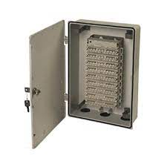
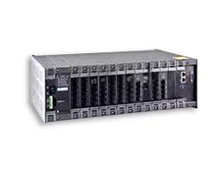
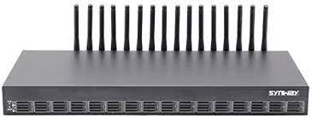
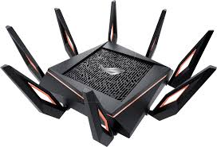


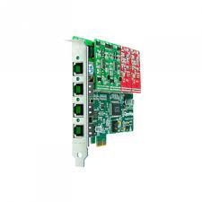

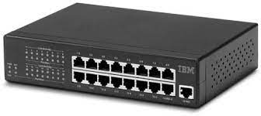

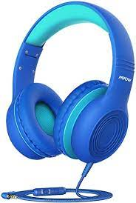
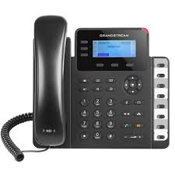

Case Study AKS University
Architecture with PRI Line And GSM Gateway
University Departments
EPABX
For Internal
Communication
Admin
HR
PRI Line
GSM Gateway
Internet for Departments
Accounts
Management
Agent Floor
PRI Card
Wi-Fi Router
Avyukta
Dialer
Suite
Switch
Admin Quality/Supervisor/TL
Agent PC
USB Headphone
IP Phone
Soft Phone
25+ Reports
Voice Logs
Complete Recordings logs
Campaign Manager

Slide 8

Case Study AKS University
To PSTN Network from
PRI / GSM from TSP
Call Flow with PRI Line And GSM Gateway
INB and OB Calls
University Departments
EPABX
For Internal
Communication
PRI Line
Admin
HR
GSM Gateway
Internet for Departments
Accounts
Management
Agent Floor
PRI Card
Wi-Fi Router
Avyukta
Dialer
Suite
Switch
Admin Quality/Supervisor/TL
Agent PC
USB Headphone
IP Phone
Soft Phone
25+ Reports
Voice Logs
Complete Recordings logs
Campaign Manager

Slide 9
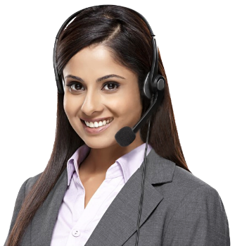


Political Elections / Campaigns
Insurance / Shares / Loan / DSA’s
Taxi Services / BPO / Collections
Restaurant / Hotels / Customer Care
E com / Mobile Apps / Website
Survey / Appointment Setting / Lead generation
Astrology / Universities / Colleges
Recruitment / MIS / Placements / Admissions
24 X 7 X 365 “Decade” of 1900+ Satisfied BPO’s
avyuktaindia
Predictive / Auto Dialer: Current Calls/ Output X 400%
Hosted / Premised / BPO / DoT VoIP / PRI / GSM Gateway
Smart IVR / Cloud Telephony / Omni Channel / CRM / API
OBD / Press 1/ Voice SMS / Masking / OTP / 1800
Survey / Appointment Setting / Lead Generation
Domestic International Call Center / BPO Setup
The Competition Assassinators
275+ Live Ref. Centres
11 Yrs. X Asterisks Dev.
9 Countries,91+ Cities
Live Demo / PoC
Lower than the Lowest Professional Bidder
All possible Techno-commercial models
No Blame Game : Your CTI-CRM-VoIP “SPOC”
100% Gov. Compliance
72 HR Refund Policy
10% Ref. discount/s
24X6 Support NoC
“The” single Answer to your
A to Z
Tel- ”e” - calling requirements
+1-408-791-3820
+91-856-00-00-600
sales@dialerindia.com
Avyukta Intellicall www.dialerindia.com

Slide 10





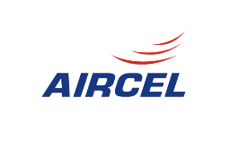










Trust over 11+ years
Some* Major Clients

Slide 11
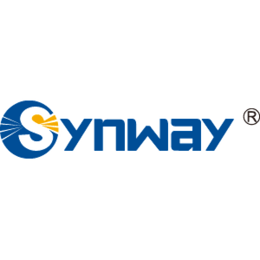

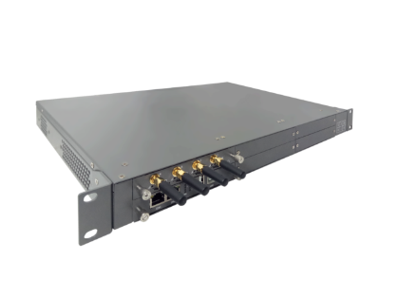


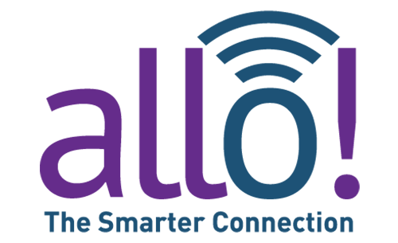
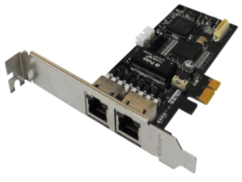



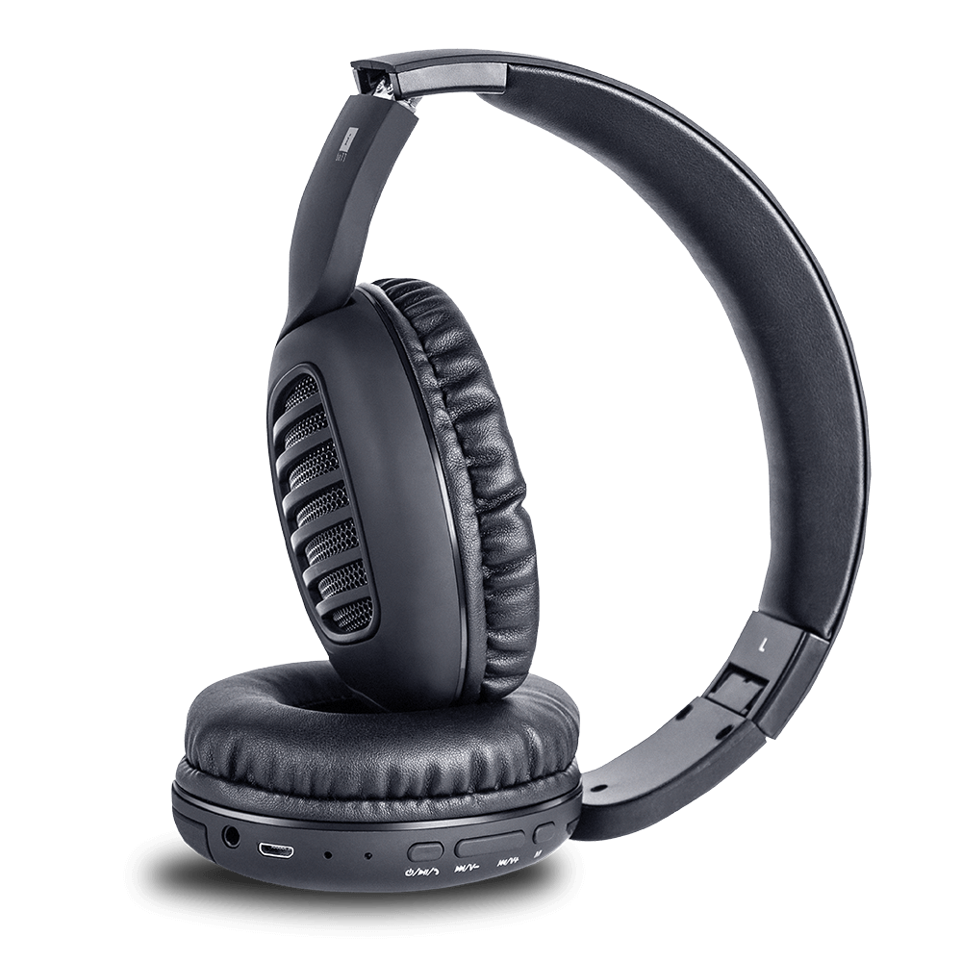




CTI Hardware Partners

Slide 12
Useful links
Domestic Architectures
International Architectures
Demo Video
Video Tutorials
Sample Voice Overs, Jingles and Melodies
DoT License / OSP Registration
PRI card / GSM Gateway / IP Phones / Headphone Buy Online
Vendor Comparison
Avyukta CRM Demo Video
Avyukta Sales CRM Demo Video
Avyukta Task CRM Demo Video
Avyukta Today CRM Demo Video
Request a Demo
Avyukta Client CRM Login
Support SLA
Avyukta on Youtube
Avyukta on Linkedin

Slide 13
Regrow Hair Clinic Case Study
Thank You for Your Time

